Slide 1
Lecture 14
Knowledge-based Agents
Yaohang Li
Department of Computer Science
ODU
Reading for This Class:
Chapter 7, 8, 9, Russell and Norvig

Slide 2
Review
Last Class
Alpha-Beta Pruning
This Class
Knowledge-based Agent
Next Class
Inference

Slide 3
Knowledge-based Agents
Knowledge base
A set of sentences
Expressed in a knowledge representation language
Represent some assertion about the world
Inference
Derive new sentences from old
Logical agents
Two Tasks
TELL
Add new sentences to the knowledge base
ASK
Query what is known
Have to obey the fundamental requirements

Slide 4
Knowledge-Based Agent
sensors
?
environment
agent
actuators
Knowledge
base

Slide 5
Types of Knowledge
Procedural, e.g.: functions Such knowledge can only be used in one way -- by executing it
Declarative, e.g.: constraints It can be used to perform many different sorts of inferences

Slide 6
Logic
Logic is a formal language for representing information such that conclusion can be drawn
Logic is a declarative language to:
Assert sentences representing facts that hold in a world W (these sentences are given the value true)
Syntax
Representing Language
Be Well-Formed
Semantics
The truth of each sentence with respect to each possible world
Deduce the true/false values to sentences representing other aspects of W

Slide 7
Model
Model
In place of “possible world”
Fix the truth or falsehood of every relevant sentence
Phase “m is a model of sentence a”
Means sentence a is true in model m
Can represent infinity worlds

Slide 8
Entailment
Logical Entailment between Sentences
A sentence follows logically from another sentence
α β
In every model in which α is true, β is also true
Logical reasoning
If α (old knowledge) is true and entails β (new knowledge)
Then β is also true

Slide 9
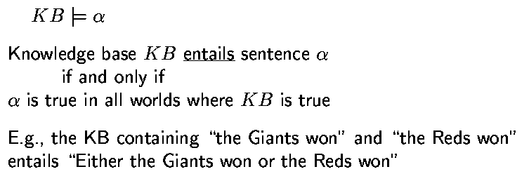
Entailment: Possible Worlds Semantics
Adapted from slides by S. Russell, UC Berkeley

Slide 10
Connection World-Representation
Sentences
entail
Sentences
represent
represent
Conceptualization
World W
Facts about W
Facts about W
hold
hold

Slide 11
Examples of Logics
Propositional calculus A ∧ B ⇒ C
First-order predicate calculus ( x)( y) Mother(y,x)
Logic of Belief B(John,Father(Zeus,Cronus))

Slide 12
Symbols of Propositional Logic
Logical Connectives: ¬, ∧, ∨, ⇒, ⇔
Propositional symbols, e.g., P, Q, R, …
True, False
sentence ∧ sentence is called a conjunction
sentence ∨ sentence is called a disjunction

Slide 13
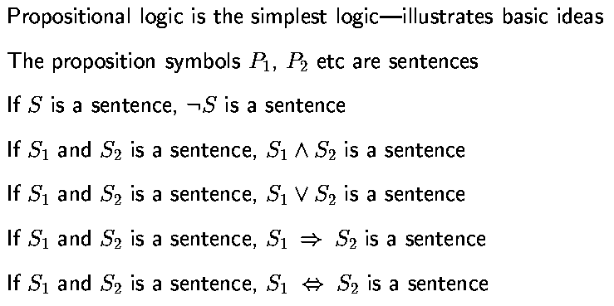
Propositional Logic: Syntax
Adapted from slides by S. Russell, UC Berkeley

Slide 14
Syntax of Propositional Logic
sentence → atomic sentence | complex sentence
atomic sentence → Propositional symbol, True, False
Complex sentence → ¬sentence | (sentence ∧ sentence) | (sentence ∨ sentence) | (sentence ⇒ sentence)
| (sentence ⇔ sentence)
Examples:
((P ∧ Q) ⇒ R)
(A ⇒ B) ∨ (¬C)
Counter examples:
(A ∧ ⇒ R)
(A B) ∨ (¬C)

Slide 15
Order of Precedence
Priority
¬ ∧ ∨ ⇒
Examples:
¬ A ∨ B ⇒ C is equivalent to ((¬A)∨B)⇒C
A ⇒ B ⇒ C is incorrect
(A ⇒ B) ⇒ C
A ⇒ (B ⇒ C)

Slide 16
Model of Propositional Logic
Assignment of a truth value – true or false – to every atomic sentence
Examples:
Let A, B, C, and D be the propositional symbols
m = {A=true, B=false, C=false, D=true} is a model
m’ = {A=true, B=false, C=false} is not a model
With n propositional symbols, one can define 2^{n} possible models

Slide 17
Compare!
BLOCK(A), BLOCK(B), BLOCK(C)
ON(A,B), ON(B,C), ONTABLE(C)
ON(A,B) ∧ ON(B,C) ⇒ ABOVE(A,C)
A
B
→ ABOVE(A,C)
C
HUMAN(A), HUMAN(B), HUMAN(C)
CHILD(A,B), CHILD(B,C), BLOND(C)
CHILD(A,B) ∧ CHILD(B,C) ⇒ GRAND-CHILD(A,C)
→ GRAND-CHILD(A,C)

Slide 18
Semantics of PL
It specifies how to determine the truth value of any sentence in a model m
The truth value of True is True
The truth value of False is False
The truth value of each atomic sentence is given by model m
The truth value of every other sentence is obtained recursively by using truth tables

Slide 19
Truth Tables
A | B | ¬ A | A ∧ B | A ∨ B | A ⇒ B
True | True | False | True | True | True
True | False | False | False | True | False
False | False | True | False | False | True
False | True | True | False | True | True

Slide 20
About ⇒
ODD(5) ⇒ CAPITAL(Japan,Tokyo)
EVEN(5) ⇒ SMART(Sam)
Read A ⇒ B as: “If A IS True, then I claim that B is True, otherwise I make no claim.”

Slide 21
Example
Model: A=True, B=False, C=False, D=True
(¬A ∨ B ⇒ C) ⇒ D ∧ A
F
F
T
T
T
Definition: If a sentence s is true in a model m, then m is said to be a model of s

Slide 22
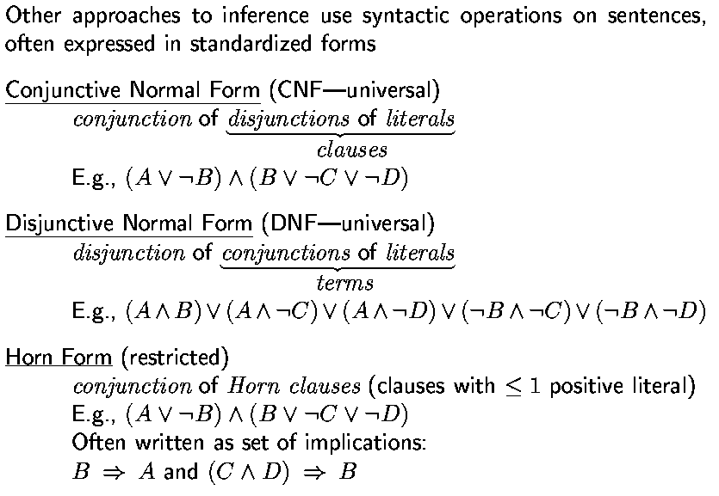
Normal Form

Slide 23
A Small Knowledge Base
Battery-OK ∧ Bulbs-OK ⇒ Headlights-Work
Battery-OK ∧ Starter-OK ∧ ¬Empty-Gas-Tank ⇒ Engine-Starts
Engine-Starts ∧ ¬Flat-Tire ⇒ Car-OK
Headlights-Work
¬Car-OK
Sentences 1, 2, and 3 → Background knowledge
Sentences 4 and 5 → Observed knowledge

Slide 24
Model of a Knowledge Base
Let KB be a set of sentences
A model m is a model of KB iff it is a model of all sentences in KB, that is, all sentences in KB are true in m
Example
How many models are there for the following sentences?
A V B
A ⇒ B
How many models are there for the following KB?
A V B
A ⇒ B

Slide 25
Satisfiability of a KB
A KB is satisfiable iff it admits at least one model; otherwise it is unsatisfiable
KB1 = {P, ¬Q∧R} is satisfiable KB2 = {¬P∨P} is satisfiable
KB3 = {P, ¬P} is unsatisfiable
valid sentence or tautology

Slide 26
Validity
A sentence is valid if it is true in all models
Example
A∨¬A
A⇒A
(A∧(A⇒B)) ⇒B
Valid sentence is known as tautology
Deduction Theorem
For any sentences α and β, α β if and only if the sentence (α ⇒ β) is valid
Known to the ancient Greeks
Give us a way to justify entailment

Slide 27
Logical Entailment
KB : set of sentences
α : arbitrary sentence
KB entails α – written KB α – iff every model of KB is also a model of α

Slide 28
Logical Entailment
KB : set of sentences
α : arbitrary sentence
KB entails α – written KB α – iff every model of KB is also a model of α
Alternatively, KB α iff
{KB,¬α} is unsatisfiable
KB ⇒ α is valid

Slide 29
Logical Equivalence
Two sentences α and β are logically equivalent – written α ≡ β -- iff they have the same models, i.e.: α ≡ β iff α β and β α

Slide 30
Logical Equivalence
Two sentences α and β are logically equivalent – written α ≡ β -- iff they have the same models, i.e.: α ≡ β iff α β and β α
Examples:
(α ∧ β) ≡ (β ∧ α)
α ⇒ β ≡ ¬α ∨ β
¬(α ∧ β) ≡ ¬α ∨ ¬β
¬(α ∨ β) ≡ ¬α ∧ ¬β

Slide 31
Logical Equivalence
Two sentences α and β are logically equivalent – written α ≡ β -- iff they have the same models, i.e.: α ≡ β iff α β and β α
Examples:
(α ∧ β) ≡ (β ∧ α)
α ⇒ β ≡ ¬α ∨ β
¬(α ∧ β) ≡ ¬α ∨ ¬β
¬(α ∨ β) ≡ ¬α ∧ ¬β
One can always replace a sentence by an equivalent one in a KB

Slide 32
Summary
Logic
Knowledge-based Agent
Propositional Logic
Order of Precedence

Slide 33
What I want you to do
Review Chapter 7, 8, 9
Work on your assignment

